Slide 1
Your Interests and Career Choice
Student Learning Outcomes:
Understand Holland’s six interest themes
Identify interest themes and how they align with work environments
Recognize how combinations of interests can be present in work environments

Slide 2
Interests
The supreme accomplishment is the blur the line between work and play. --Arnold Toynbee
Finding career options that suit your interests plays a central role in determining whether you’ll like your work and be happy.
However, some of your top leisure interests may not be easily fulfilled in your job.
By the time you’re an adult, your career interests are relatively stable.
That means if you choose something you like at age 25, you’ll continue to like it at age 50.

Slide 3
Origin of Interests
Having a skill doesn’t necessarily mean you would enjoy using it in a career, and having an interest doesn’t mean you’d be good at it.
Bobby’s dad made him play basketball, and he was good at it. What he really wanted to do was play guitar, but he didn’t have much time to practice because of basketball. Playing basketball was a skill, but guitar was an interest.
Exposure to a variety of interests and subjects may have been limited in the past.
You will have more freedom and opportunities in college to try out different things. See where your interests (and skills) lie!

Slide 4
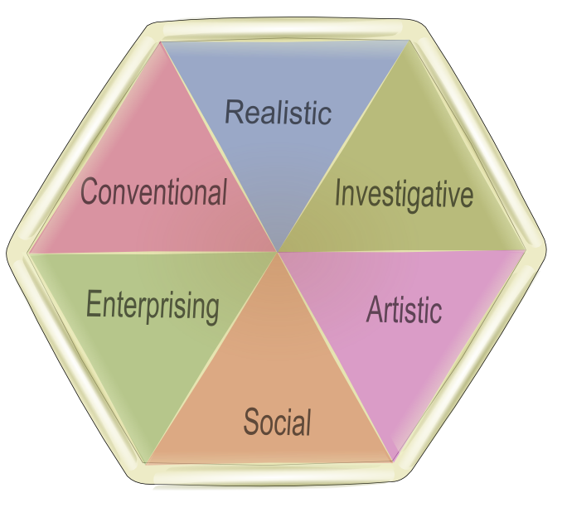
Holland’s Interest Themes
R
6 interest themes placed on a hexagon.
People (and work environments) can be categorized into 1 (or a combo) of themes.
People should seek out types of work that match their themes.
C
I
E
A
S
Notes:
Don’t take the theme names too literally. Holland’s definitions of the themes are different from the common meanings of these terms.

Slide 5
Holland’s RIASEC
Each person and occupation is described with a 2 or 3 letter code that combines 2 or 3 of the six types. For example:
SAE: Social, Artistic, Enterprising
RI: Realistic, Investigative
ASC: Artistic, Social, Conventional
Notes:
This is the person’s Holland Theme Code.

Slide 6
Realistic (The Doers)
Likely to be: | Environments often involve: | Examples of Occupations:
Action-oriented Concrete thinkers Constructive Drawn to outdoors Hands-on Mechanical Observant Physical Practical | Adventurous activities Athletics Building things Clear lines of authority Fixing or repairing things Manufacturing Operating machinery Using physical strength Using tools with precision Outdoors Include animals or plants | Civil Engineers (RIC) Automotive Mechanics (RI) Surgical Technologists (RSC) Airline Pilots (RCI) Clinical Lab Techs (RIC) Freight & Cargo Inspectors (RC)

Slide 7
Investigative (The Thinkers)
Likely to be: | Environments often involve: | Examples of Occupations:
Academic Complex Independent Intellectual Scientific Self-motivated Task-oriented Theoretical Unstructured | Analyzing and observation Computer work Critical thinking Laboratory work Mathematics Research Solving complex problems Thinking and writing about new ideas Working with data | Environmental scientists (IRC) Surgeons (IRS) Computer software engineers (IRC0 Obstetricians (ISR) Pharmacists (ICS) Clinical psychologists (ISA) Market research analysts (IEC)

Slide 8
Artistic (The Creators)
Likely to be: | Environments often involve: | Examples of Occupations:
Creative Dramatic Flexible Imaginative Intuitive Musical Non-conforming Self-expressive Unique | Creating artwork Designing Expressing individuality Music and instruments Performing Unstructured activities Using ideas to create something Working independently Writing or composing | Fashion designers (AER) Film and video editors (AEI) Interpreters and translators (AS) Poets, lyricists, and creative writers (AI) Music directors (AI) Multimedia artists and animators (AI)

Slide 9
Social (The Helpers)
Likely to be: | Environments often involve: | Examples of Occupations:
Cooperative Empathetic Friendly Generous Helpful Humanistic Idealistic Insightful Understanding | Counseling Helping Listening Nurturing or healing Social service activities Supporting Teaching Volunteer activities Working in a group | Elementary school teachers (SAC) Occupational therapists (SI) Probation officers (SEC) Registered nurses (SIC) Athletic trainers (SRI) Mental health counselors (SIA)

Slide 10
Enterprising (The Persuaders)
Likely to be: | Environments often involve: | Examples of Occupations:
Ambitious Assertive Competitive Driven to succeed Energetic Influential Leadership-oriented Resilient Risk-takers | Business and corporate activities Debating Directing others Entertaining Entrepreneurship Managing people and projects Political activities Promotional activities and marketing Speaking in front of large groups | Advertising and promotion managers (EAC) Construction managers (ERC) Chief executives (EC) Lawyers (EI) Sales and marketing managers (EC) Criminal investigators and special agents (EI)

Slide 11
Conventional (The Organizers)
Likely to be: | Environments often involve: | Examples of Occupations:
Accurate Conscientious Detail-oriented Efficient Organized Patient Practical Structured Systematic | Accounting and numbers Budgeting Business and office activities Data management Making charts and graphs Operating computers Record keeping Technical activities Writing reports | Immigration and customs inspectors (CER) Loan officers (CES) Accountants (CE) City and regional planning aides (CR) Purchasing agents (CE) Paralegals and legal assistants (CIE)

Slide 12
Your Holland Theme Code
Take the Holland Theme Code Assessment that came with this presentation to find out where you fit. This is a good starting point to research possible careers.
Let your coach know when you’re ready to find careers!!
Rank | Interest Theme
 | Realistic (Doers)
 | Investigative (Thinkers)
 | Artistic (Creators)
 | Social (Helpers)
 | Enterprising (Persuaders)
 | Conventional (Organizers)
Your Holland Theme Code
1 | 2 | 3
Notes:
Some believe that the first letter in your code will largely determine your career choice, since the majority of your interests likely fall into that category.
The first theme is sometimes referred to as your “passion”, or what you’re drawn to do with your life. The other two themes may indicate how oyou would like to pursue your passion.

